Slide 1

Article Viewership
Report
Al Qabas — Kuwait Real Estate Market Analysis
February 15 – 19, 2026

Slide 2
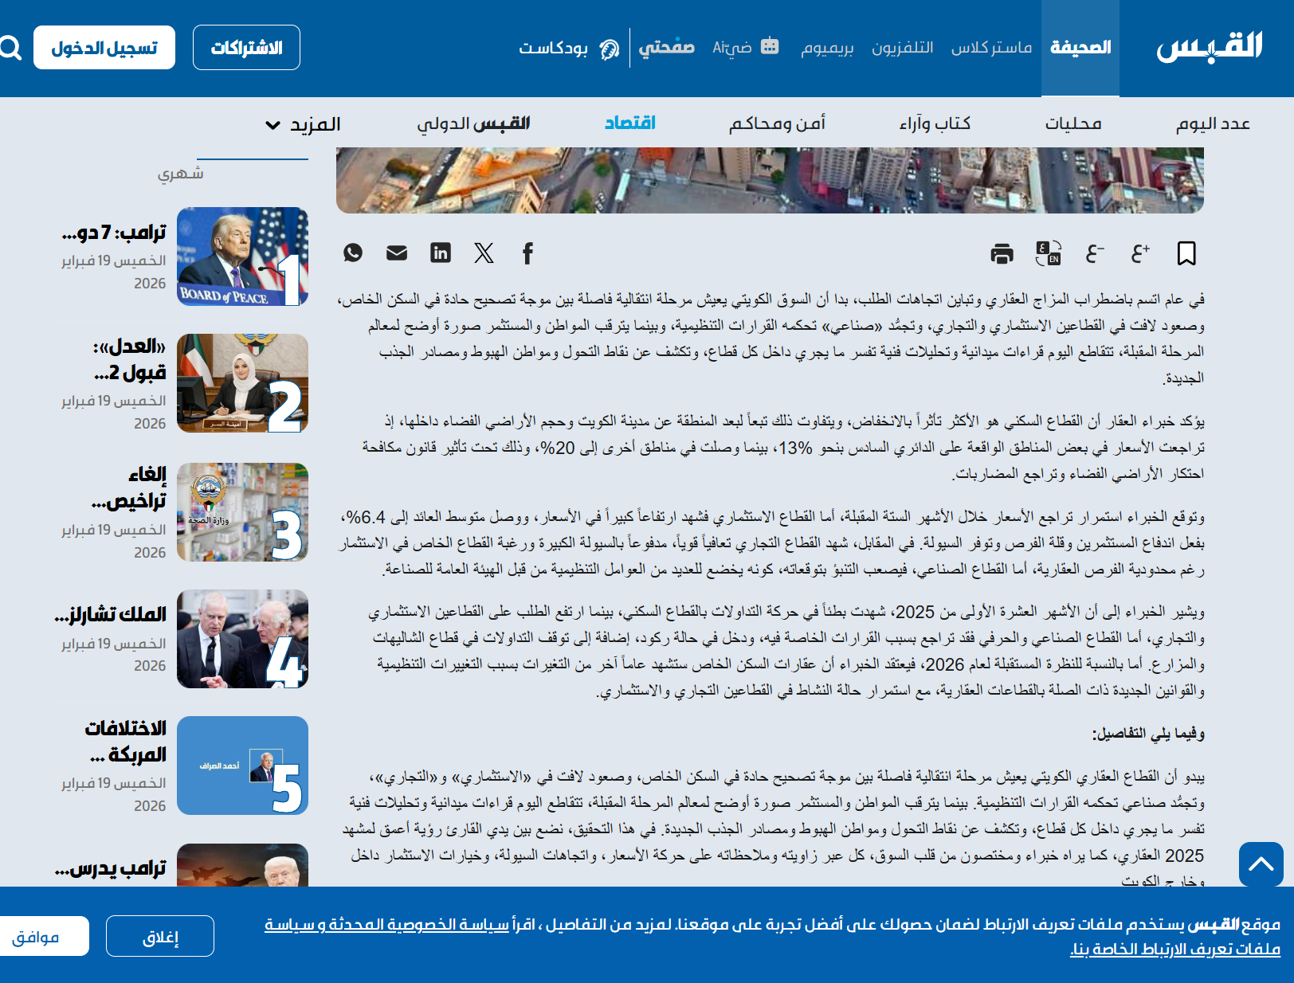

TOTAL VIEWERSHIP
92,385
Total Article Views
5
18,477
23,053
Days Live
Avg. Daily Views
Peak Day Views

Slide 3

INDUSTRY BREAKDOWN
Viewers by Industry
Construction
18,565
Engineering Services
8,415
Oil & Gas
7,707
Civil Engineering
7,597
Real Estate
5,318
Business Consulting
5,200
Accounting
4,529
Architecture & Planning
4,496
Food & Beverage
3,677
Building Construction
3,223

Slide 4

KEY DECISION-MAKERS
Senior & Leadership Viewers
32,937
Senior-level and above viewers
14,567
10,919
3,462
1,798
Managers
Senior Professionals
Directors
Business Owners
1,034
995
162
C-Suite (CXO)
Vice Presidents
Partners

Slide 5

TOP COMPANIES REACHED
Viewers by Organization
01
Alghanim International
880 views
07
ABJ Engineering & Contracting
281 views
02
Kharafi National
668 views
08
KEO International Consultants
265 views
03
HEISCO
450 views
09
Kuwait Oil Company
258 views
04
Combined Group Contracting (KSC)
438 views
10
KCCEC
250 views
05
NBTC Group
396 views
11
Arabi Company W.L.L.
242 views
06
Pace | Architecture, Engineering + Planning
350 views
12
KNPC
227 views
25+ companies with 150+ views each — spanning construction, engineering, oil & gas, real estate, and financial services across Kuwait.

